Slide 1
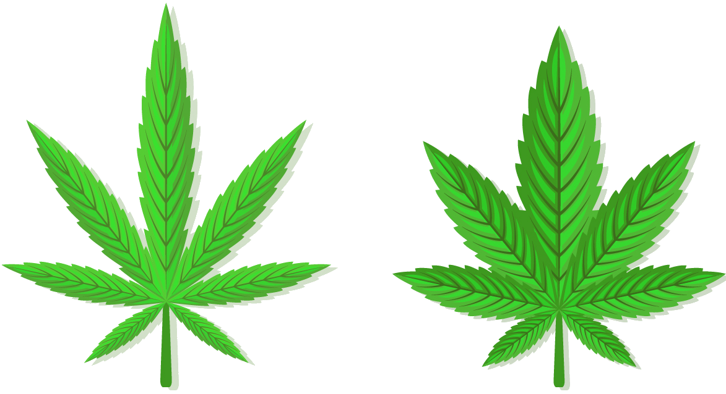
Sativa
Indica
Cannabis Analysis
Avitay Ingerman
Daniel Ofir
Hybrid
?

Slide 2

The Research
Background
Most of the cannabis strains that exist today are genetical descendants of 2 main strain types – Sativa & Indica.
As the popularity of cannabis increased in the last years thanks to countries legalizing the plant, the number of available strains increased accordingly.
New strains are created by hybridization of 2 existing strains.
Today, the 3 main types are: Sativa, Indica and Hybrid.
Our Goal
Create a Machine Learning model that can predict a strain’s type, based on a set of different features.

Slide 3
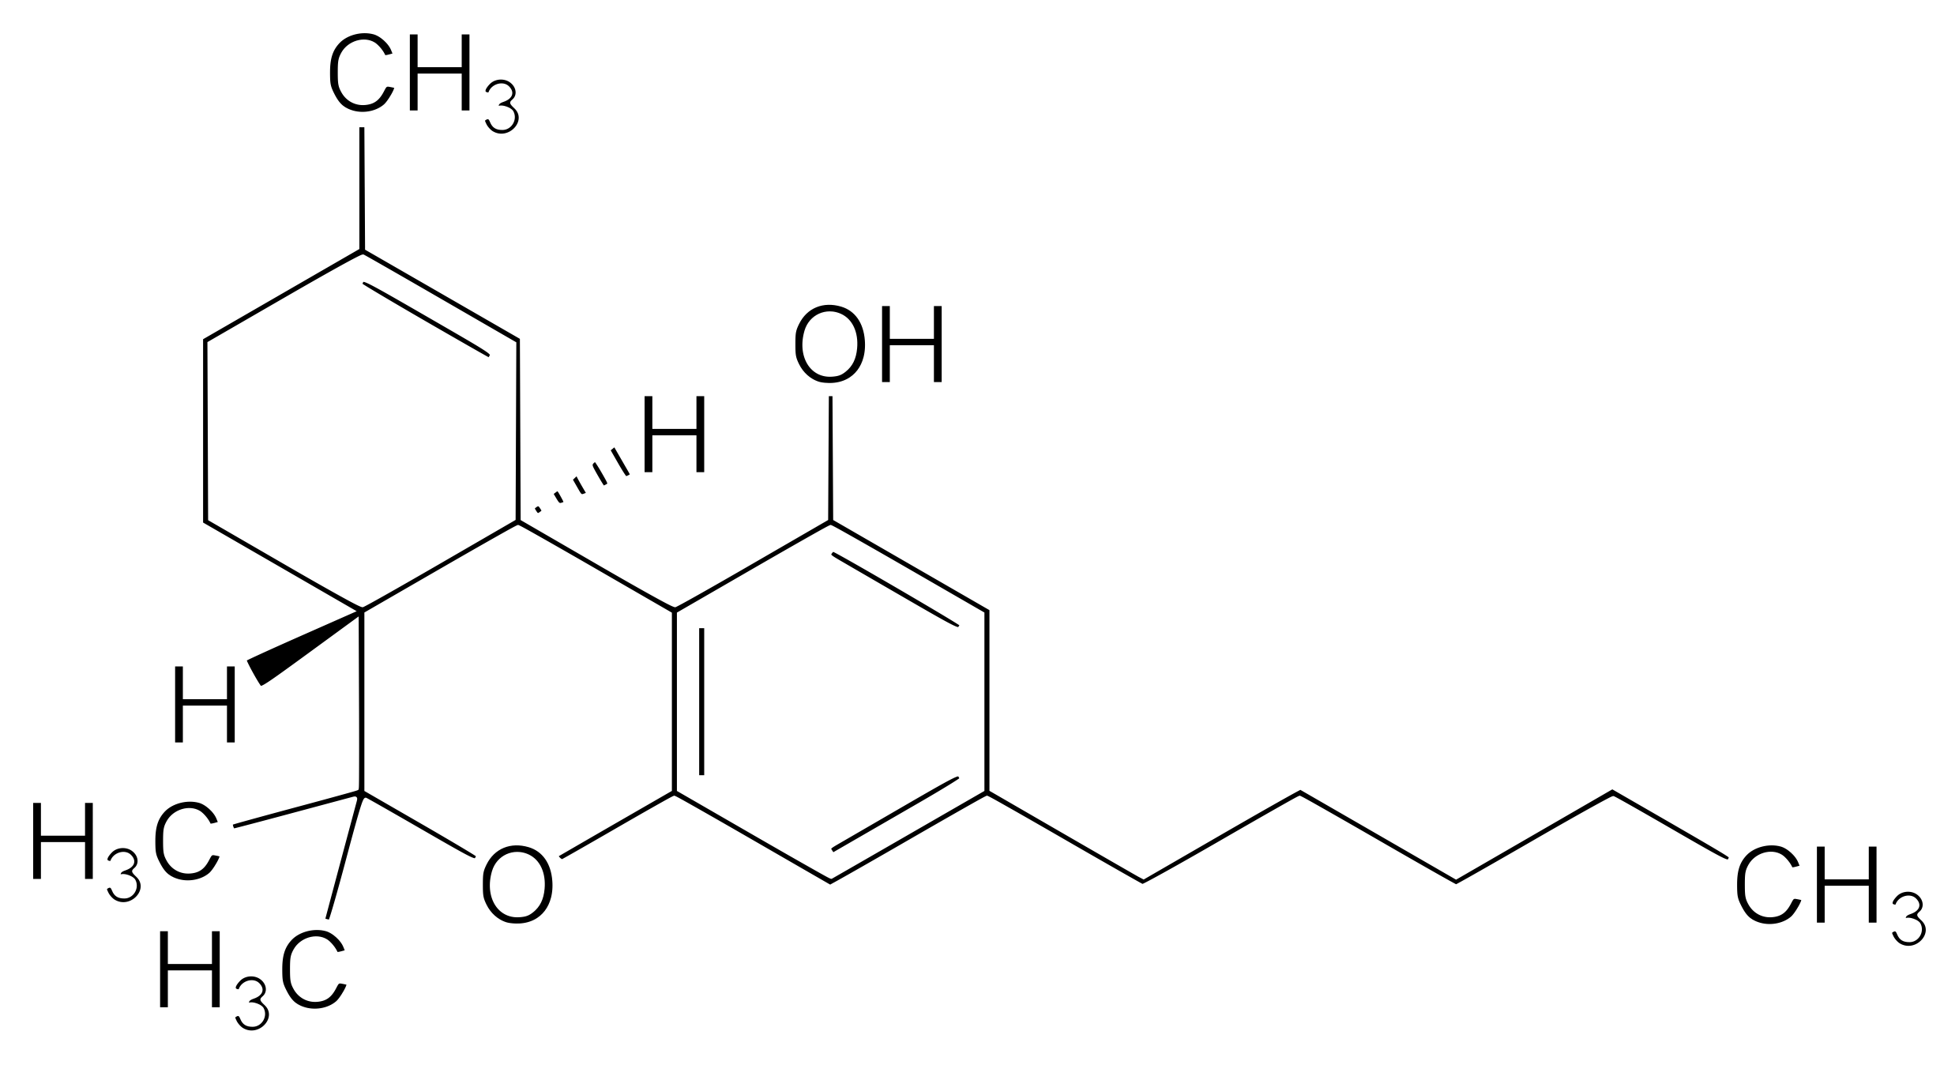
The Process
Data Acquisition
Data Scrubbing
EDA
(Data exploration)
Machine Learning Modeling
Scrape the web to get data about strains
Format, clean and complete missing data
Visualization of different aspects of the data
Create a ML model to predict the type of strain

Slide 4
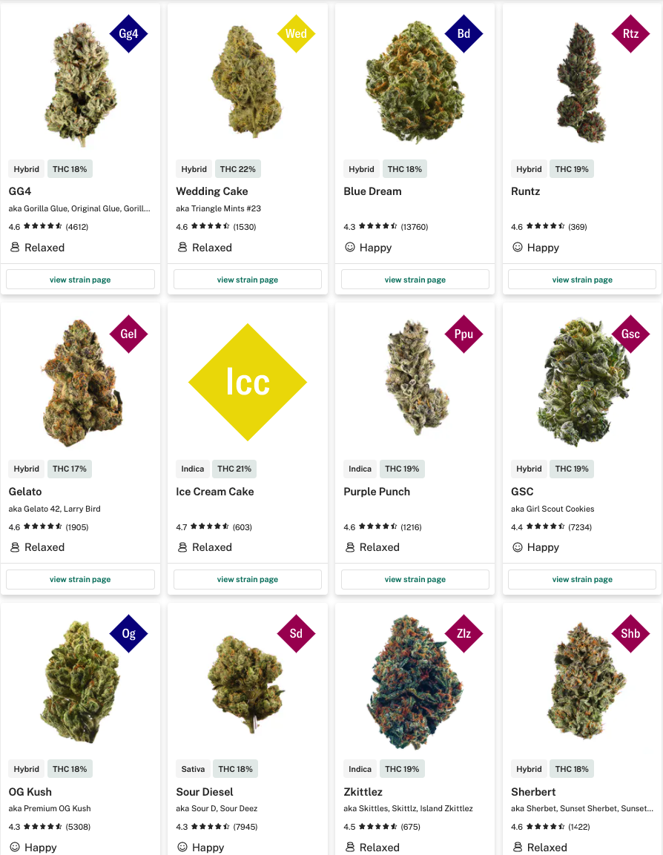
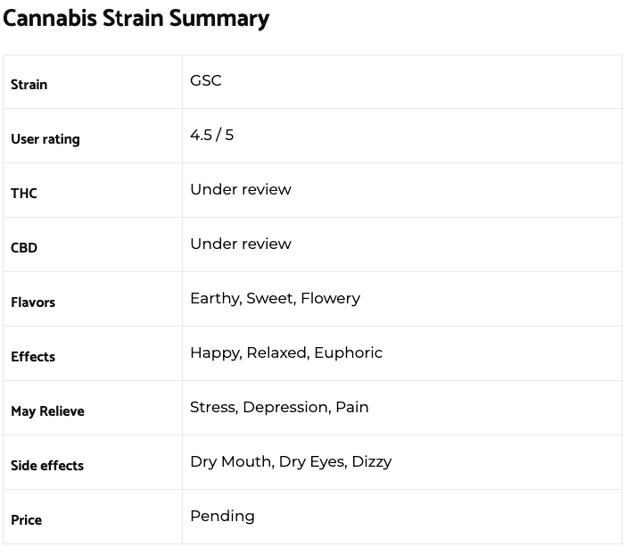
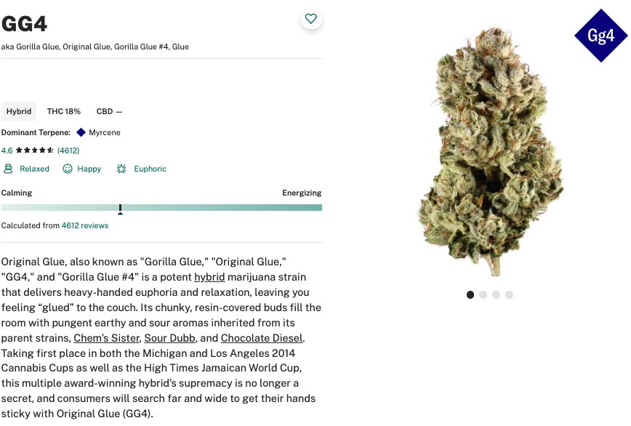
Data Acquisition
Sources
Leafly
Strain Of Weed
From “Strain of weed” we got the flavors
From “Leafly” we got data such as
feelings, medical conditions which the
strain helps with, THC %, top terpene and more…

Slide 5


Data Acquisition – Tools & Methods
Tools
BeautifulSoup - a library that makes it easy to scrape information from web pages .
Selenium - Selenium is a WebDriver for Python, designed to mimic access to a website using an internet browser.
ThreadPool - a software design pattern for achieving concurrency of execution of a task.
Thread Pool
Task Queue

Slide 6
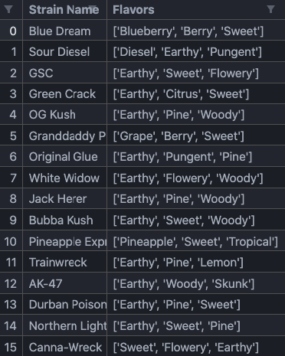
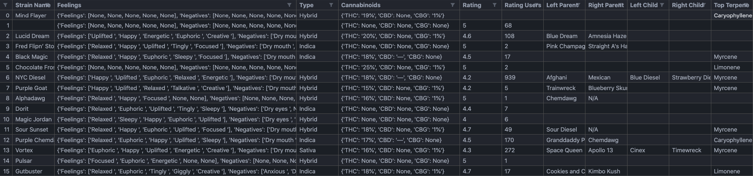
Data Acquisition – Process
Process
When we first tried to scrape data from “Leafly”, we found the site is loading dynamic content using JavaScript. In order to acquire the data, we used a package called “Selenium”.
The first crawl took ~5 hours, which caused us to want to reduce the time. To do that, we used a ThreadPool, which allows us to perform multiple I/O dependent processes concurrently. By doing so, we reduced the crawling time to ~30 minutes.
We found another website, “Strain of Weed”, which had a lot of data regarding flavors of strains. This data did not exist in “Leafly”, so we scraped that data and added it to our data.
strainofweed_df.csv
leafly_df.csv

Slide 7

Data Scrubbing
Convert data from single to column to multiple columns
Merge both Dataframes based on strain name
Fill missing values
Removed missing values that can’t be filled

Slide 8
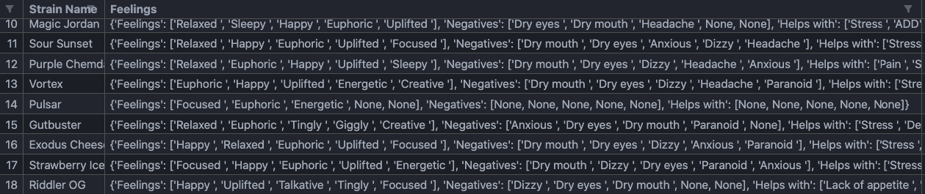
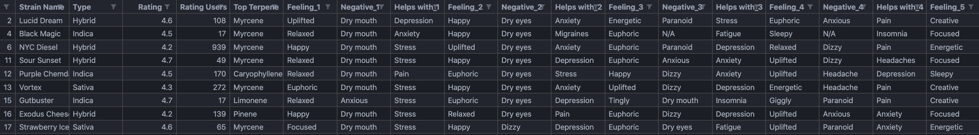
Data Scrubbing – Convert columns
Why?
While scraping the data, we used a single column to represent different types of similar data. i.e we used the column “Feelings” to represent data about different positive and negative feelings, as well as medical condition the strain is helpful with.
After conversion there are multiple columns, each representing a type of feeling.

Slide 9
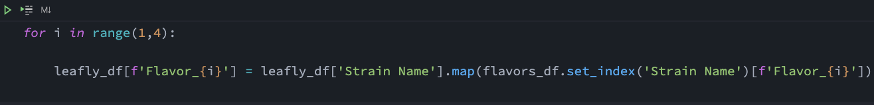
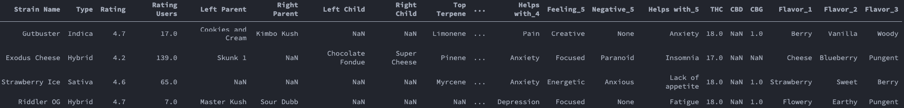
Data Scrubbing – Merge Dataframes
Merge by strain name
Dataframe after merge

Slide 10
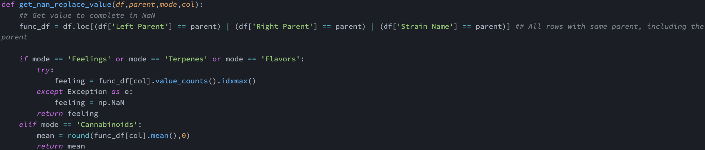
Data Scrubbing – Missing data filling
How?
As strains are gentic “children” of other strains, it makes sense that a strain will inherit some features from its’ ”parents”.
An example is THC % - for strains that are missing this data we built a dataframe that contains the parent strains, as well as all their children. Then, we took the mean value of that dataframe in order to determine the THC % in our strain that is missing that data.

Slide 11


EDA – Strain Data
THC% Distribution
CBD% Distribution
Most of the strains contain 15 – 20 % THC
Unlike THC, most of the CBD % values are under 2.5%

Slide 12
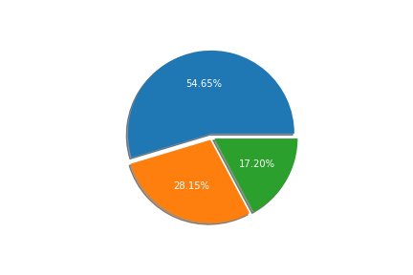
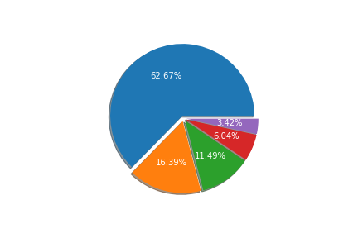
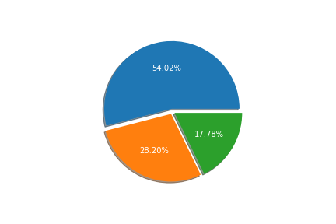
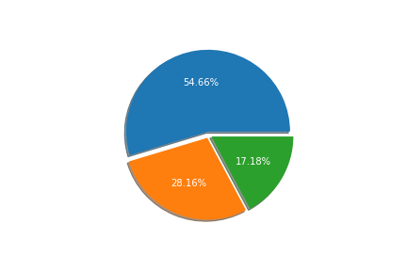
EDA – Strain Data
Strain Types
Most Common Terpenes
More than 50% of our data are “Hybrid” strains
The most common terpene is Myrcene
Top 3 Flavors / Feelings – Strain Type Dist
The ratio between the types remains the same, which shows
That all types share the same top flavors.
The same happens for ”Top 3 Feelings”

Slide 13
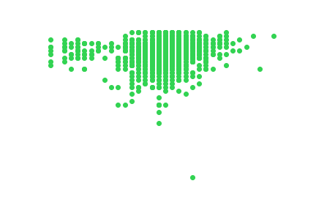
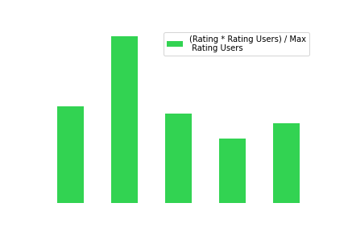
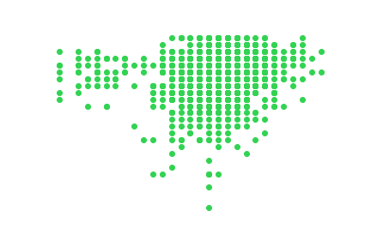
EDA – Strain Rating
Rating by THC %
Strains with under 15% THC usually have high rating.
At around 15% we can see lower rating.
Over 15% the amount of low ratings is decreasing.
We can see some outliers, so they were cleaned.
Top Rated Strains
The calculation is:
(Rating * Rating Users) / Max Rating Users
Pre-EDA
Post-EDA

Slide 14

Machine Learning
The Goal
Create a model that can predict whether a strain is “Hybrid”, “Sativa” or “Indica”.
The Method
We used ‘sklearn’ library and Logistic Regression method to train and predict the strain type.
The reason we chose Logistic Regression is that our type of predicition is a classification problem.
Logistic Regression
Feelings
Terpenes
Indica / Sativa / Hybrid
THC %
Flavors

Slide 15


Machine Learning
Results
We tried different approaches to get the most accurate result.
Between ”No scaling”, ”Standard Scaling” and “MinMax Scaling” we found the difference in accuracy is minor.
The results show around 64% successful predictions.
Playing around with the data
As about 55% of the strains in our data are “Hybrid” strains, we tried to remove all those strains and train our model to differentiate only between “Indica” and “Sativa”.
The results show around 84% successful predictions.

Slide 16
Conclusions
Nowadays, most the cannabis strains are classified as “Hybrid” as there are almost no pure “Sativa” and “Indica” strains.
A new strain is a “child” of one or two parent strains, therefore it takes qualities and properties from both parents.
That supports our prediction success, which shows it is hard to determine whether a strain is Hybrid, Sativa or Indica, since the Hybrid strains might have properties of both Sativa and Indica strains.
When we ran our model on a dataset that does not contain Hybrid strains, the success rate was much higher, which also supports the claim that Hybrid strains might have properties of both Sativa and Indica strains.

